Slide 1
DATA MINING
presentation by
Hüseyin TURGUT
Mehmet Akif Ersoy University, Turkey

Slide 2
Intro
Artificial Intelligence
Database
Knowledge base
DATA MINING
Software
Methods
Examples
algorithm
In mathematics and computer science,
an algorithm is a step-by-step
procedure for calculations.
Algorithms are used for calculation,
data processing, and
automated reasoning.
1 /42
Hüseyin TURGUT – Mehmet Akif Ersoy University, Turkey

Slide 3
algorithm
Intro
Artificial Intelligence
Database
Knowledge base
DATA MINING
Software
Methods
Examples
data
info
Process
arithmetic logic
(ALU)
?
?
?
?
?
?
2 /42
Hüseyin TURGUT – Mehmet Akif Ersoy University, Turkey

Slide 4
Data
Info
Process
Intro
Artificial Intelligence
Database
Knowledge base
DATA MINING
Software
Methods
Examples
Data; meaningless symbols…
meaningless
undefined
valueless
For example :
1
Ğ
3 /42
Hüseyin TURGUT – Mehmet Akif Ersoy University, Turkey

Slide 5
Data
Info
Process
Intro
Artificial Intelligence
Database
Knowledge base
DATA MINING
Software
Methods
Examples
INFO; Information is that which informs, i.e. that from which data can be derived. (information)
For example :
HÜSEYİN
My name
Romania flag
4 /42
Hüseyin TURGUT – Mehmet Akif Ersoy University, Turkey

Slide 6
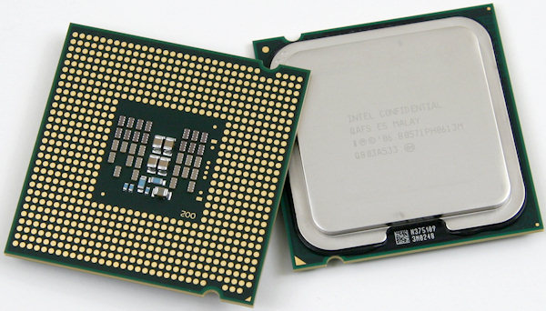
Data
Info
Process
Intro
Artificial Intelligence
Database
Knowledge base
DATA MINING
Software
Methods
Examples
PROCESS;
Converting from data to info…
Humans doing
Doing by computers
by brain
by processor (CPU)
5 /42
Hüseyin TURGUT – Mehmet Akif Ersoy University, Turkey

Slide 7
Programming
Intro
Artificial Intelligence
Database
Knowledge base
DATA MINING
Software
Methods
Examples
We can find INFO by using algorithms,
DATA ALGORITHM INFO
INPUT
PROCESS
RESULT
OK
OK
?
6 /42
Hüseyin TURGUT – Mehmet Akif Ersoy University, Turkey

Slide 8
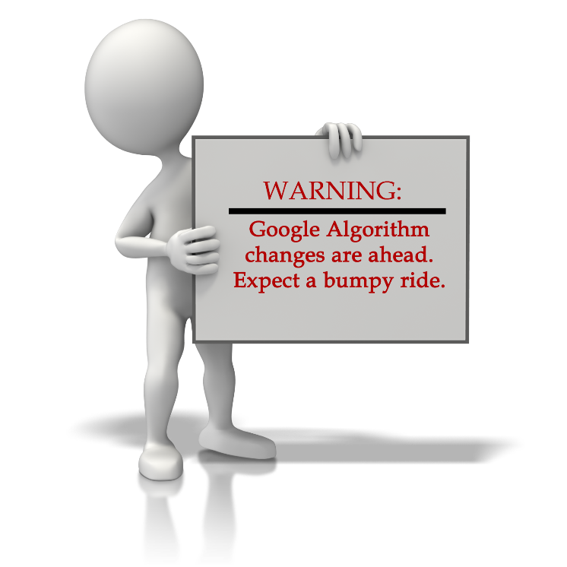
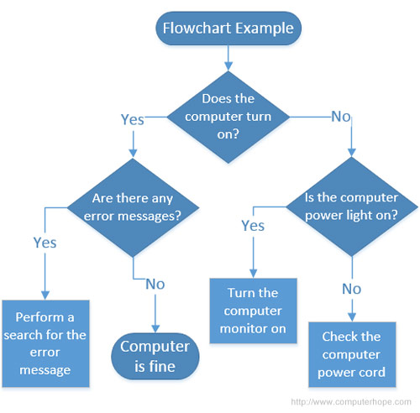
Intro
Artificial Intelligence
Database
Knowledge base
DATA MINING
Software
Methods
Examples
Algorithm
7 /42
Hüseyin TURGUT – Mehmet Akif Ersoy University, Turkey

Slide 9
Intro
Artificial Intelligence
Database
Knowledge base
DATA MINING
Software
Methods
Examples
ARTIFICIAL INTELLIGENCE
Summary
We can find PROCESS by using Artificial Intelligence
DATA ALGORITHM INFO
INPUT
PROCESS
RESULT
OK
?
OK
8 /42
Hüseyin TURGUT – Mehmet Akif Ersoy University, Turkey

Slide 10
Intro
Artificial Intelligence
Database
Knowledge base
DATA MINING
Software
Methods
Examples
ARTIFICIAL INTELLIGENCE
For Example (by human)
1
2
3
4
5
6
7
n
2
4
6
8
10
12
14
2n
INPUT
f(n)
OUTPUT
We can find f(n) as “f(n)=2n”
9 /42
Hüseyin TURGUT – Mehmet Akif Ersoy University, Turkey

Slide 11
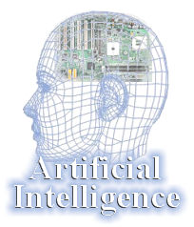
Intro
Artificial Intelligence
Database
Knowledge base
DATA MINING
Software
Methods
Examples
ARTIFICIAL INTELLIGENCE
Of course, for finding formula,
it has got experience or precedents.
AI can not create a new idea.
BUT IT CAN TRY
10 /42
Hüseyin TURGUT – Mehmet Akif Ersoy University, Turkey

Slide 12
Intro
Artificial Intelligence
Database
Knowledge base
DATA MINING
Software
Methods
Examples
AI in Areas
kinds of AI algorithm
space
automotive
banking
defense
electronic
Finance
production
health
Robotics
security
Machine Intelligence (Symbolic Artificial Intelligence)
Artificial Neural Networks (Cybernetics Artificial Intelligence)
Natural language processing (language and thinking)
Speech Synthesis (Artificial Speech)
Speaking Understanding (Speech Analysis)
Expert systems
Pattern Recognition
Genetic Algorithms
genetic Programming
fuzzy Logic
Multiple samples Learning (Multiple Instance Learning)
11 /42
Hüseyin TURGUT – Mehmet Akif Ersoy University, Turkey

Slide 13
DataBase
Intro
Artificial Intelligence
Database
Knowledge base
DATA MINING
Software
Methods
Examples
A database is
an organized collection of data.
A database is a collection of information that is organized so that it can easily be accessed, managed, and updated. The data are typically organized to model relevant aspects of reality in a way that supports processes requiring this information.
12 /42
Hüseyin TURGUT – Mehmet Akif Ersoy University, Turkey

Slide 14
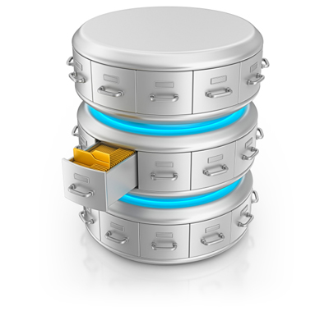
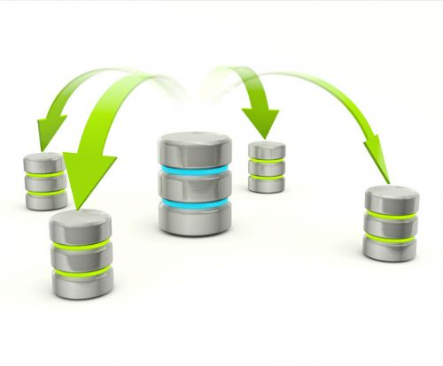
DataBase
Intro
Artificial Intelligence
Database
Knowledge base
DATA MINING
Software
Methods
Examples
STORE RESTORE
13 /42
Hüseyin TURGUT – Mehmet Akif Ersoy University, Turkey

Slide 15
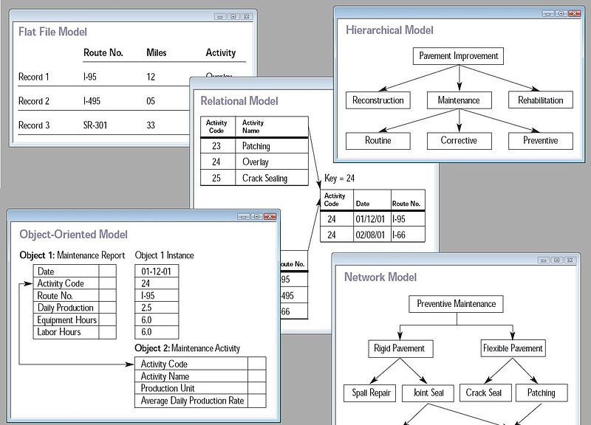
DataBase
Intro
Artificial Intelligence
Database
Knowledge base
DATA MINING
Software
Methods
Examples
Find all credit applicants with last name of Smith.
Identify customers who have purchased more than $10,000 in the last month.
Find all customers who have purchased milk
14 /42
Hüseyin TURGUT – Mehmet Akif Ersoy University, Turkey

Slide 16
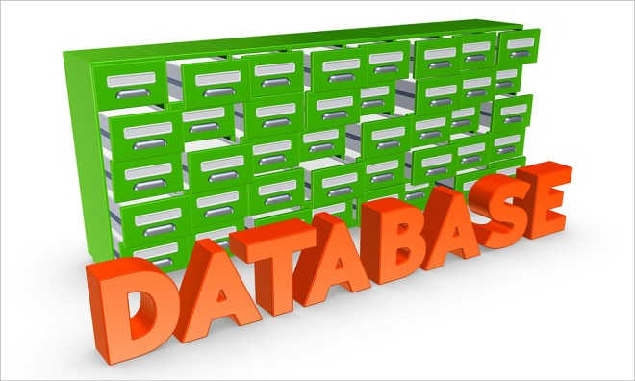
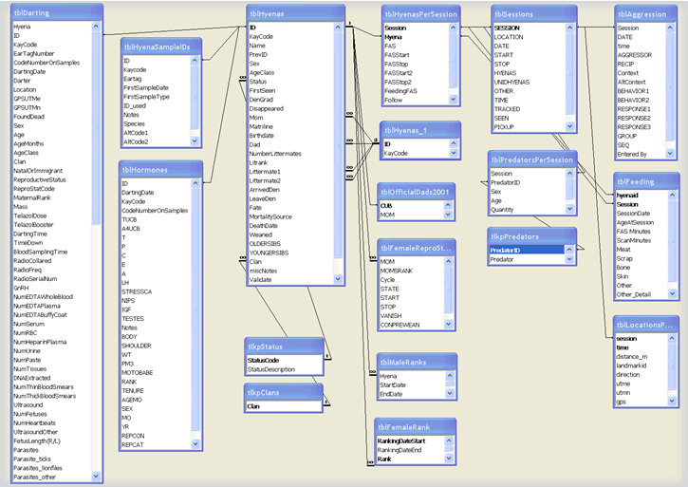
Intro
Artificial Intelligence
Database
Knowledge base
DATA MINING
Software
Methods
Examples
There are a lot of datas. These occur at result of processing registers. DB is lists of datas.
15 /42
Hüseyin TURGUT – Mehmet Akif Ersoy University, Turkey

Slide 17
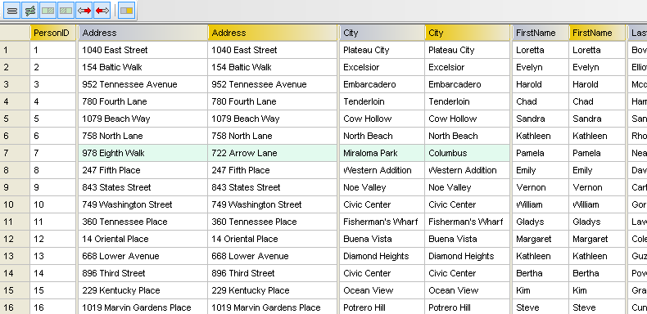
DataBase
Intro
Artificial Intelligence
Database
Knowledge base
DATA MINING
Software
Methods
Examples
16 /42
Hüseyin TURGUT – Mehmet Akif Ersoy University, Turkey

Slide 18
Intro
Artificial Intelligence
Database
Knowledge base
DATA MINING
Software
Methods
Examples
More data is generated:
Bank, telecom, other business transactions ...
Scientific Data: astronomy, biology, etc
Web, text, and e-commerce
More data is captured:
Storage technology faster and cheaper
DBMS capable of handling bigger DB
17 /42
Hüseyin TURGUT – Mehmet Akif Ersoy University, Turkey

Slide 19
In general, a knowledge base is a centralized repository for information: a public library, a database of related information about a particular subject, and
could all be considered to be examples of knowledge bases.
In relation to tnformation technology (IT), a knowledge base is a machine-readable resource for the dissemination of information, generally online or with the capacity to be put online. An integral component of knowledge management systems, a knowledge base is used to optimize information collection, organization, and retrieval for an organization, or for the general public.
Intro
Artificial Intelligence
Database
Knowledge base
DATA MINING
Software
Methods
Examples
18 /42
Hüseyin TURGUT – Mehmet Akif Ersoy University, Turkey

Slide 20
Intro
Artificial Intelligence
Database
Knowledge base
DATA MINING
Software
Methods
Examples
A collection of knowledge in the form of subject-problem-solution information that pertains to a specific topic or subject of interest.
The data is typically stored in a searchable database. One popular example of a knowledge base is the Microsoft Help & Support Knowledge Base.
19 /42
Hüseyin TURGUT – Mehmet Akif Ersoy University, Turkey

Slide 21
Knowledge Base (KLOG)
Intro
Artificial Intelligence
Database
Knowledge base
DATA MINING
Software
Methods
Examples
A knowledge base is a database used for knowledge sharing and management.
20 /42
Hüseyin TURGUT – Mehmet Akif Ersoy University, Turkey

Slide 22
Intro
Artificial Intelligence
Database
Knowledge base
DATA MINING
Software
Methods
Examples
21 /42
Hüseyin TURGUT – Mehmet Akif Ersoy University, Turkey

Slide 23
Data Mining
Intro
Artificial Intelligence
Database
Knowledge base
DATA MINING
Software
Methods
Examples
Data Mining is:
(1) The efficient discovery of previously unknown, valid, potentially useful, understandable patterns in large datasets
(2) The analysis of (often large) observational data sets to find unsuspected relationships and to summarize the data in novel ways that are both understandable and useful to the data owner
22 /42
Hüseyin TURGUT – Mehmet Akif Ersoy University, Turkey

Slide 24
Data Mining
Intro
Artificial Intelligence
Database
Knowledge base
DATA MINING
Software
Methods
Examples
Data mining is integral part of knowledge discovery in databases (KDD), which is the overall process of converting raw data into useful information.
This process consists of series of transformation steps from preprocessing to postprocessing of data mining results.
23 /42
Hüseyin TURGUT – Mehmet Akif Ersoy University, Turkey

Slide 25
Data Mining
Intro
Artificial Intelligence
Database
Knowledge base
DATA MINING
Software
Methods
Examples
Integration
Interpretation
& Evaluation
Data Mining
RawData
Transformation
__
____
__
____
__
____
Patterns
and
Rules
Selection
& Cleaning
Transformed
Data
DATA
Ware
house
Target
Data
24 /42
Hüseyin TURGUT – Mehmet Akif Ersoy University, Turkey

Slide 26
Data Mining
Intro
Artificial Intelligence
Database
Knowledge base
DATA MINING
Software
Methods
Examples
Process of semi-automatically analyzing large databases to find patterns that are:
valid: hold on new data with some certainity
novel: non-obvious to the system
useful: should be possible to act on the item
understandable: humans should be able to interpret the pattern
Also known as Knowledge Discovery in Databases (KDD)
25 /42
Hüseyin TURGUT – Mehmet Akif Ersoy University, Turkey

Slide 27
Data Mining
Intro
Artificial Intelligence
Database
Knowledge base
DATA MINING
Software
Methods
Examples
Data Mining helps extract such information
Data Mining Tasks (Styles of learning):
Classification learning: predicting a discrete class
Association learning: detecting associations between features
Clustering: grouping similar instances into clusters
Numeric prediction: predicting a numeric quantity
Concept: thing to be learned
Concept description: output of learning scheme
26 /42
Hüseyin TURGUT – Mehmet Akif Ersoy University, Turkey

Slide 28
Data Mining
Intro
Artificial Intelligence
Database
Knowledge base
DATA MINING
Software
Methods
Examples
Data Mining is Not …
Data warehousing
SQL / Ad Hoc Queries / Reporting
Software Agents
Online Analytical Processing (OLAP)
Data Visualization
27 /42
Hüseyin TURGUT – Mehmet Akif Ersoy University, Turkey

Slide 29
Data Mining
Intro
Artificial Intelligence
Database
Knowledge base
DATA MINING
Software
Methods
Examples
Data mining: the core of knowledge discovery process.
Knowledge
Knowledge Interpretation
Data Mining
Task-relevant Data
Data transformations
Preprocessed Data
Selection
Data Cleaning
Data Integration
28 /42
Hüseyin TURGUT – Mehmet Akif Ersoy University, Turkey

Slide 30
Data mining software
Intro
Artificial Intelligence
Database
Knowledge base
DATA MINING
Software
Methods
Examples
Commercial packages (Cost ? X 10⁶ dollars)
IBM Intelligent Miner
SAS Enterprise Miner
Clementine
WEKA (Free = GPL licence!)
Java => Multi-platform
Open source – means you get source code
Bow
C codes
Netlab
Matlab function
Other….
29 /42
Hüseyin TURGUT – Mehmet Akif Ersoy University, Turkey

Slide 31
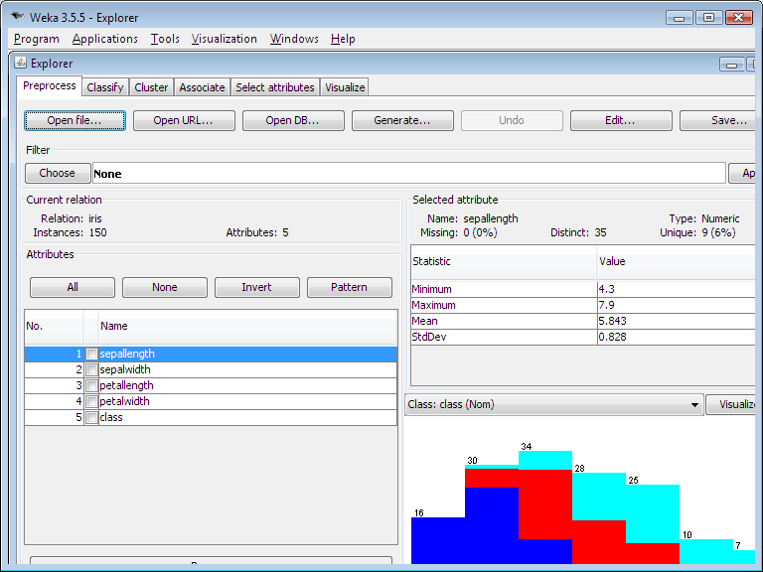
Data mining software
Intro
Artificial Intelligence
Database
Knowledge base
DATA MINING
Software
Methods
Examples
WEKA
30 /42
Hüseyin TURGUT – Mehmet Akif Ersoy University, Turkey

Slide 32
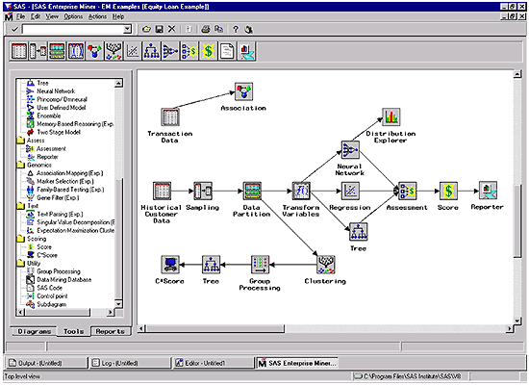
Data mining software
Intro
Artificial Intelligence
Database
Knowledge base
DATA MINING
Software
Methods
Examples
SAS
31 /42
Hüseyin TURGUT – Mehmet Akif Ersoy University, Turkey

Slide 33
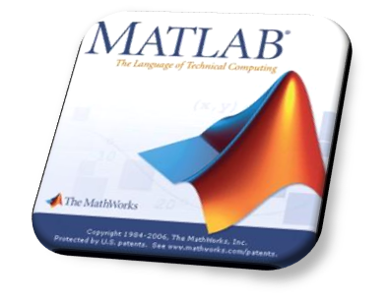
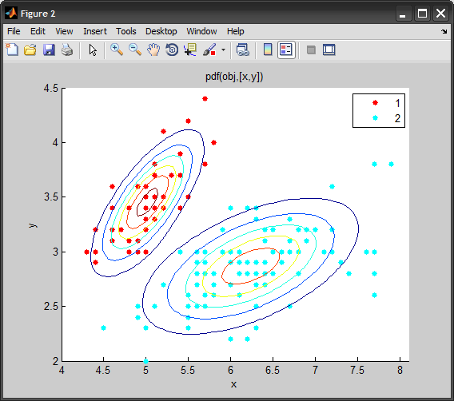
Data mining software
Intro
Artificial Intelligence
Database
Knowledge base
DATA MINING
Software
Methods
Examples
NETLAB
32 /42
Hüseyin TURGUT – Mehmet Akif Ersoy University, Turkey

Slide 34
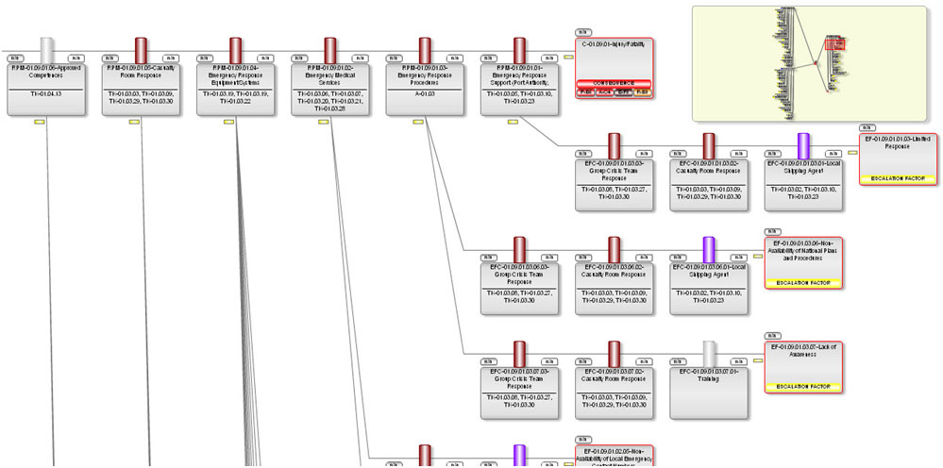
Data mining software
Intro
Artificial Intelligence
Database
Knowledge base
DATA MINING
Software
Methods
Examples
BOW
33 /42
Hüseyin TURGUT – Mehmet Akif Ersoy University, Turkey

Slide 35
Data mining software
Intro
Artificial Intelligence
Database
Knowledge base
DATA MINING
Software
Methods
Examples
Free open-source data mining software and applications
Carrot2
Chemicalize.org
ELKI
GATE
KNIME
ML-Flex
MLPACK library
NLTK (Natural Language Toolkit)
OpenNN
Orange
R
RapidMiner
SCaViS
SenticNet API
Torch
UIMA
Weka
34 /42
Hüseyin TURGUT – Mehmet Akif Ersoy University, Turkey

Slide 36
Data mining METHODs
Intro
Artificial Intelligence
Database
Knowledge base
DATA MINING
Software
Methods
Examples
1. Decision Tree Classifiers:
Used for modeling, classification
2. Association Rules:
Used to find associations between sets of attributes
3. Sequential patterns:
Used to find temporal associations in time series
4. Hierarchical clustering:
used to group customers, web users, etc
35 /42
Hüseyin TURGUT – Mehmet Akif Ersoy University, Turkey

Slide 37
Data mining step-by-step (1)
Intro
Artificial Intelligence
Database
Knowledge base
DATA MINING
Software
Methods
Examples
Data Integration
Data integration:
combines data from multiple sources into a coherent store
Schema integration
integrate metadata from different sources metadata: data about the data (i.e., data descriptors) Entity identification problem: identify real world entities from multiple data sources, e.g., A.cust-id ≡ B.cust-#
Detecting and resolving data value conflicts
for the same real world entity, attribute values from different sources are different (e.g., J.D.Smith and Jonh Smith may refer to the same person) possible reasons: different representations, different scales, e.g., metric vs. British units (inches vs. cm)
36 /42
Hüseyin TURGUT – Mehmet Akif Ersoy University, Turkey

Slide 38
Data mining step-by-step (2)
Intro
Artificial Intelligence
Database
Knowledge base
DATA MINING
Software
Methods
Examples
Data Transformation
Smoothing: remove noise from data
Aggregation: summarization, data cube construction
Generalization: concept hierarchy climbing
Normalization: scaled to fall within a small, specified range
min-max normalization
z-score normalization
normalization by decimal scaling
Attribute/feature construction
New attributes constructed from the given ones
37 /42
Hüseyin TURGUT – Mehmet Akif Ersoy University, Turkey

Slide 39
Data mining step-by-step (3)
Intro
Artificial Intelligence
Database
Knowledge base
DATA MINING
Software
Methods
Examples
Data Compression
Original Data
Compressed
Data
lossless
Original Data
Approximated
lossy
38 /42
Hüseyin TURGUT – Mehmet Akif Ersoy University, Turkey

Slide 40
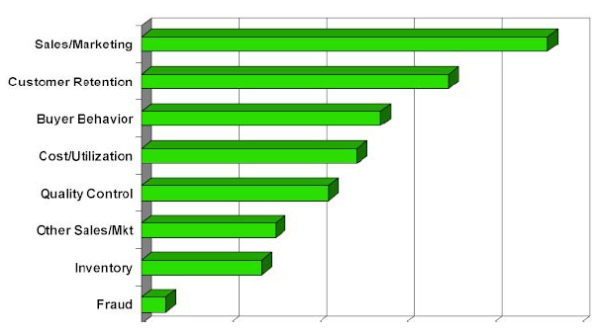
Examples & Applications
Intro
Artificial Intelligence
Database
Knowledge base
DATA MINING
Software
Methods
Examples
39 /42
Hüseyin TURGUT – Mehmet Akif Ersoy University, Turkey

Slide 41
Examples & Applications
Intro
Artificial Intelligence
Database
Knowledge base
DATA MINING
Software
Methods
Examples
Medicine disease outcome, effectiveness of treatments analyze patient disease history: find relationship between diseases
Molecular/Pharmaceutical identify new drugs
Scientific data analysis identify new galaxies by searching for sub clusters
Web site/store design and promotion find affinity of visitor to pages and modify layout
40 /42
Hüseyin TURGUT – Mehmet Akif Ersoy University, Turkey

Slide 42
Examples & Applications
Intro
Artificial Intelligence
Database
Knowledge base
DATA MINING
Software
Methods
Examples
Banking loan/credit card approval predict good customers based on old customers
Customer relationship management
identify those who are likely to leave for a competitor.
Targeted marketing
identify likely responders to promotions
Fraud detection telecommunications, financial transactions from an online stream of event identify fraudulent events
Manufacturing and production
automatically adjust knobs when process parameter changes
41 /42
Hüseyin TURGUT – Mehmet Akif Ersoy University, Turkey

Slide 43
DATA MINING
Hüseyin TURGUT
www.hturgut.com
hturgut@mehmetakif.edu.tr
Mehmet Akif Ersoy University, Turkey

